Slide 1


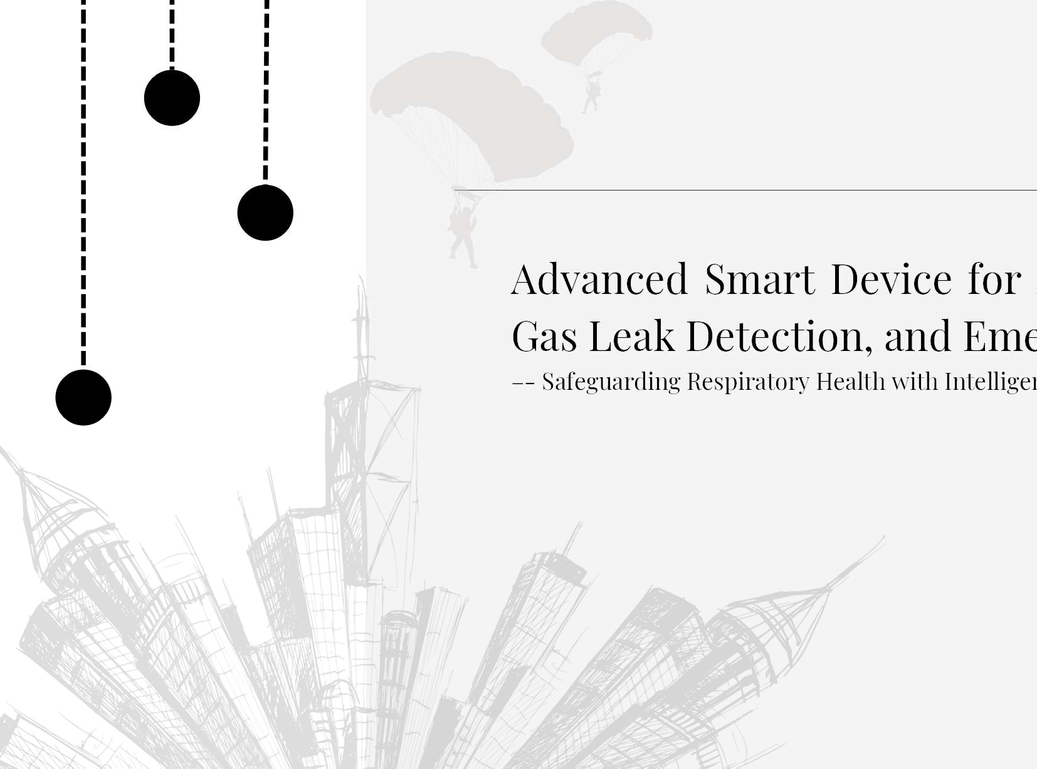

Air Quality Monitoring, rgency Response
nt Hazard Prevention
Advanced Smart Device for
Gas Leak Detection, and Eme
–- Safeguarding Respiratory Health with Intellige
Sagarika Srivastava
e-mail : sagarikasrivastava46@gmail.com LinkedIn : issrivastava46
GitHub : issrivastava

Slide 2







?
WHY
Air pollution harms health,
causing
respiratory and heart diseases, and leads to millions of premature deaths. It damages ecosystems, accelerates climate
change, and threatens Economically, it strains
biodiversity. healthcare,
reduces productivity, and harms crops. If left unchecked, i t causes irreversible environmental and societal damage.

Slide 3

WHEN ?
Waiting for the " correct time" to act against air pollution and environmental degradation only accelerates destruction and extinction. The impacts are already visible, with rising global temperatures, biodiversity loss, and increasing health crises. Procrastination allows problems to grow beyond control, threatening ecosystems and humanity' s future. Immediate, collective action is essential to prevent irreversible damage and secure a l ivable planet for future generations. The t ime to act is now.

Slide 4


WHO ?
National Governments ? Local Governments ?
International Organizations ?
Non-Governmental Organizations ( NGOs) ? World Health Organization ( WHO) ?
United Nations ( UN) ? Media ?
Communities ?
or is it YOU ?

Slide 5

WHERE ?
Start by taking action in your home and immediate surroundings to reduce air pollution,

Slide 6




HOW ?
Promoting Clean Transportation
--Bike-Sharing Programs
--Car-Free Days
Tree Planting Initiatives
--Urban Green Spaces
--Urban Forests
Waste Management
--Recycling Programs
--Ban on Open Burning

Slide 7











Local Clean Energy Projects
-- Solar Villages
-- Microgrid Projects
Awareness Campaigns
-- Community-Led Education
Local Air Quality Monitoring

Slide 8

Several IOT projects are present for air quality detection and gas leakage
however it is very expensive and one device performs only one specific function and is not very efficient.
Therfore,, i aim to create one device that can perform all functions and is affordable by a common man

Slide 9
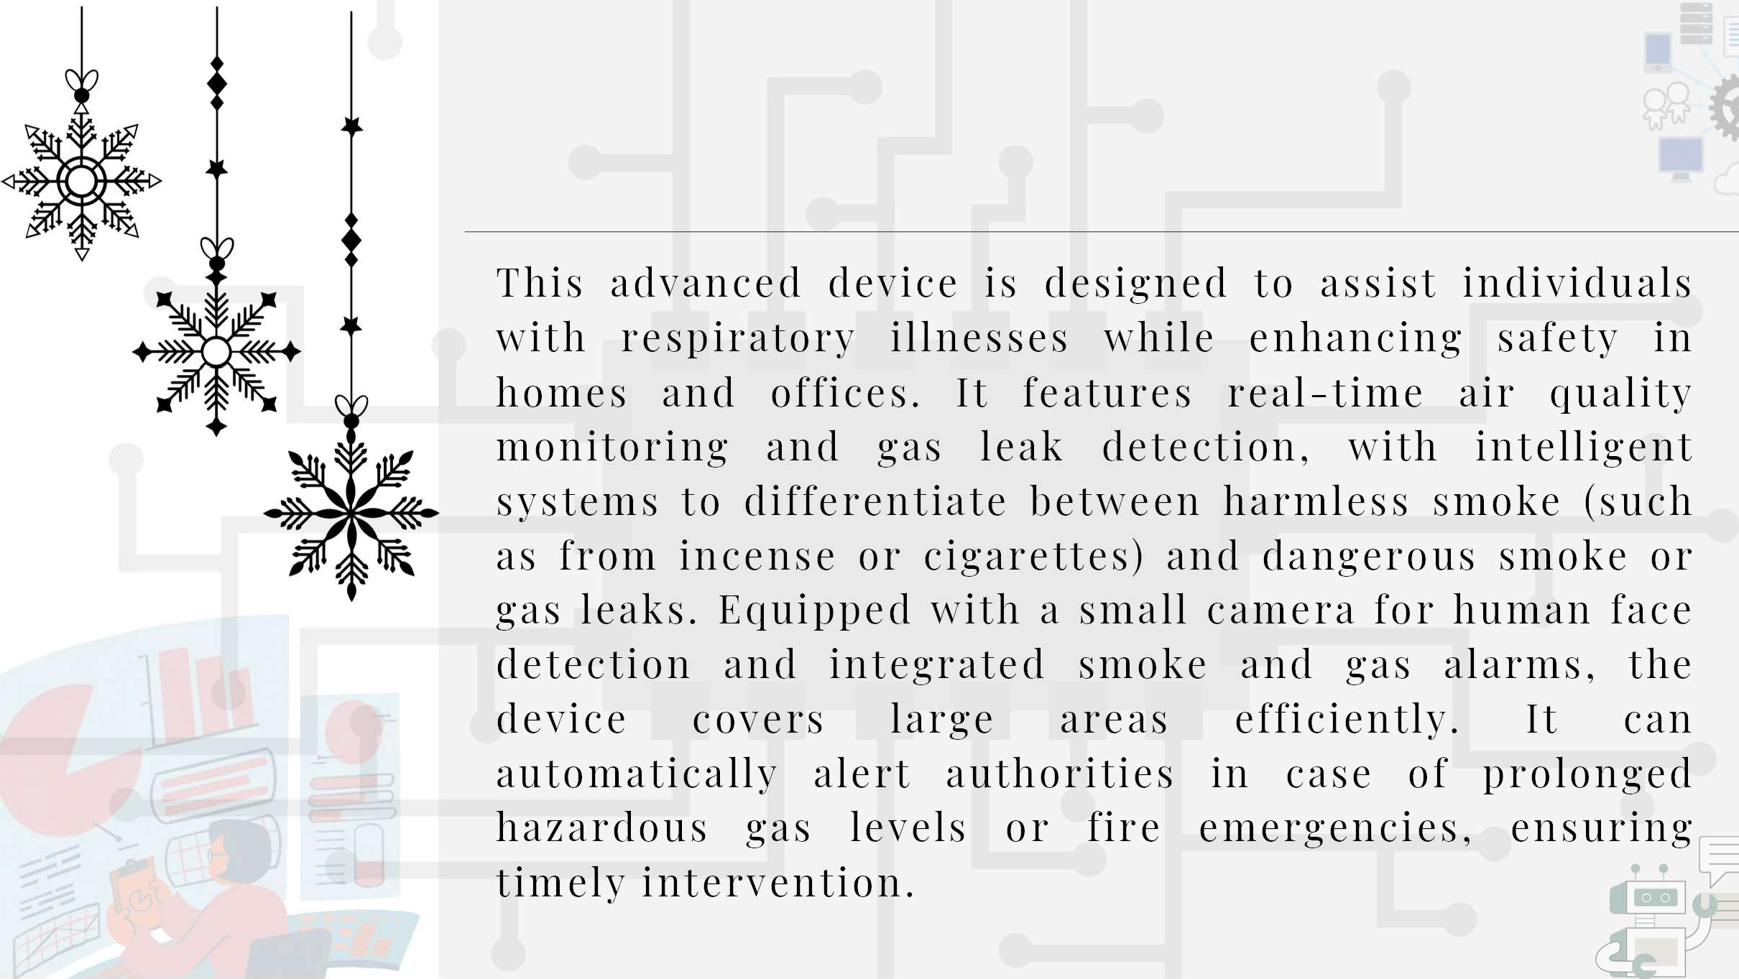
WHAT ?
This advanced device is designed to assist individuals
with respiratory i l lnesses while enhancing safety in homes and offices. It features real-time air quality monitoring and gas leak detection, with intelligent
systems to differentiate between harmless smoke ( such as from incense or cigarettes) and dangerous smoke or gas leaks. Equipped with a small camera for human face detection and integrated smoke and gas alarms, the device covers large areas efficiently. It can
automatically alert authorities in case of prolonged
hazardous gas levels or fire emergencies, ensuring t imely intervention.

Slide 10

FUNCTIONS OF MY DEVICE
SENSOR TO DETECT AIR QUALITY AND CONTENTS PERCENTAGE WISE
O 2 -% CO 2 -% ETC
LIGHT FOR INDICATION ( RED YELLOW GREEN)
DISPLAY AIR QUALITY
ALARMING SYSTEM IN CASE OF FIRE
LARGE RADIUS
CAN TELL THE DIFF BETWEEN ACTUAL SMOKE AND A PERSON SMOKING
WIFI CONNECTIVITY
RUNS ON BATTERY FOR POWER SUPPLY
ECONOMICAL
ALL COMBINED IN ONE SINGLE DEVICE THAT CAN BE HANGED ON THE WALL

Slide 11





